Slide 1
EE464 Hardware Project
DPC
Design and Manufacturing Presentation

Slide 2
Overview
Topology Selection
Design Decisions
a) Magnetic Design
b) Feedback Circuit
Simulation Results and Component Selections
Manufacturing Plans

Slide 3
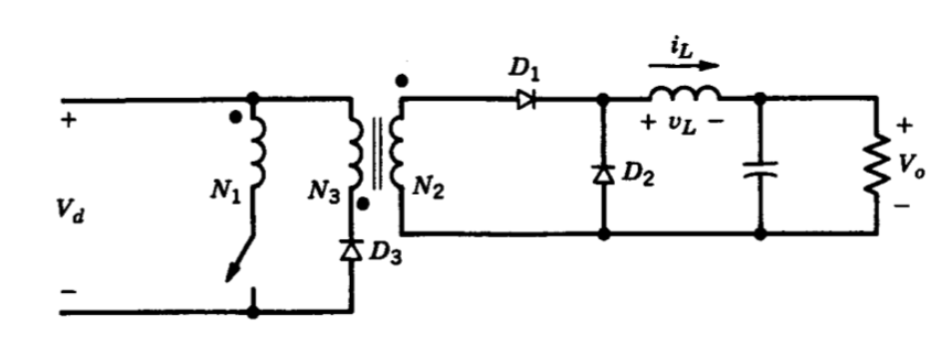
Topology Selection
ADVANTAGES OF FORWARD CONVERTER OVER FLYBACK CONVERTER
It has better utilization of transformer
It provides us higher Lm and less ripple
Higher eﬃciency
It has a non-pulsating output current due to the usage of an output inductor.

Slide 4
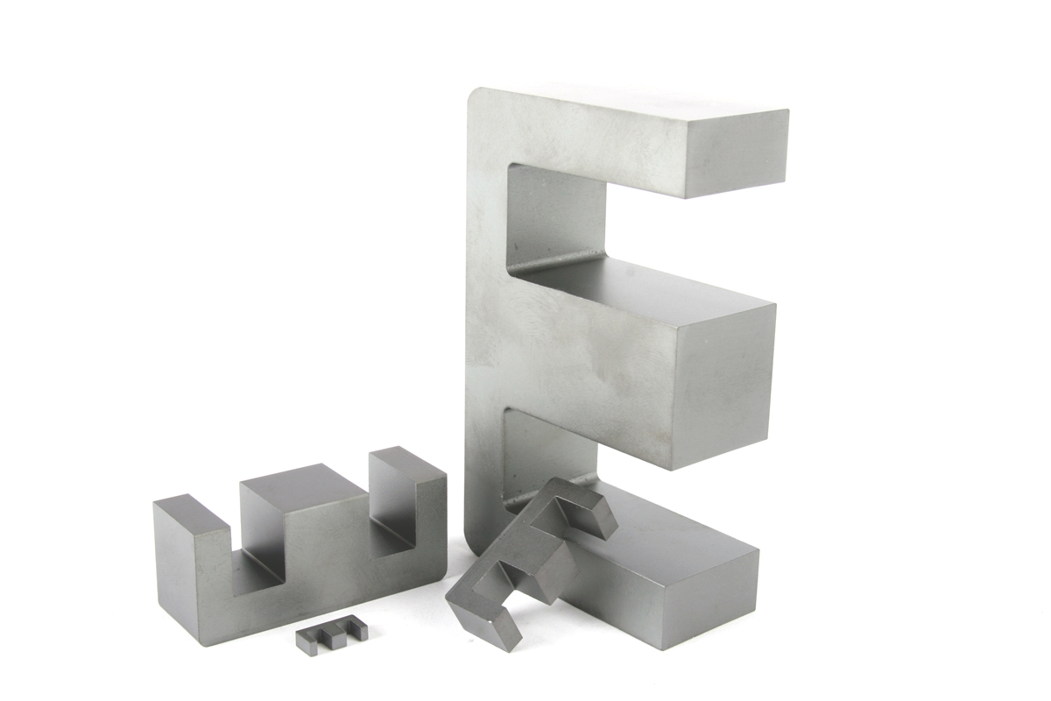
Transformer Design
Design Decisions
Ferrite over Kool Mu
Large Window Area (420 mm²)
Allows Lower Switching Frequency
Result:
0P45530EC

Slide 5
Turn Numbers
Avoid saturation
Give enough reset time (D_{max}<0.5)
Reduce Copper Losses
Result:
n₁=20, n₂=20, n₃=24

Slide 6
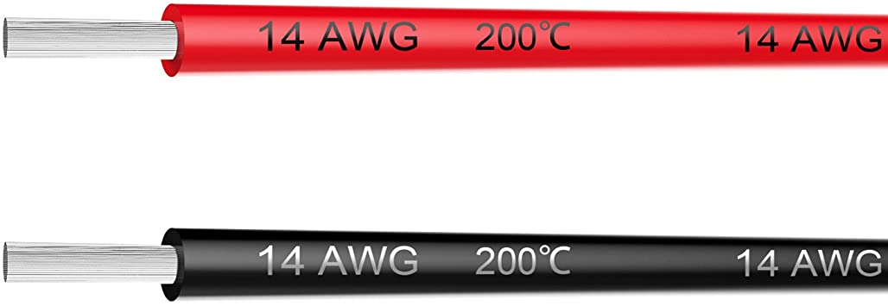
Cable Selection
Carry enough current
Reduce Copper Losses
Satisfy fill factor condition
Result:
AWG14

Slide 7
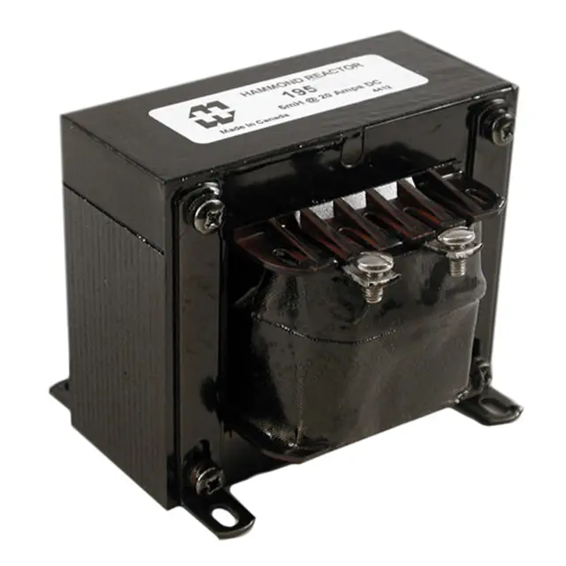
Inductor Design
Meet ripple condition
Reduce losses
Result:
3.8 mH Inductor

Slide 8
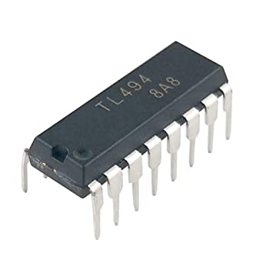
Feedback Circuit
Adjust switching frequency
Voltage feedback
Soft start
TL494

Slide 9
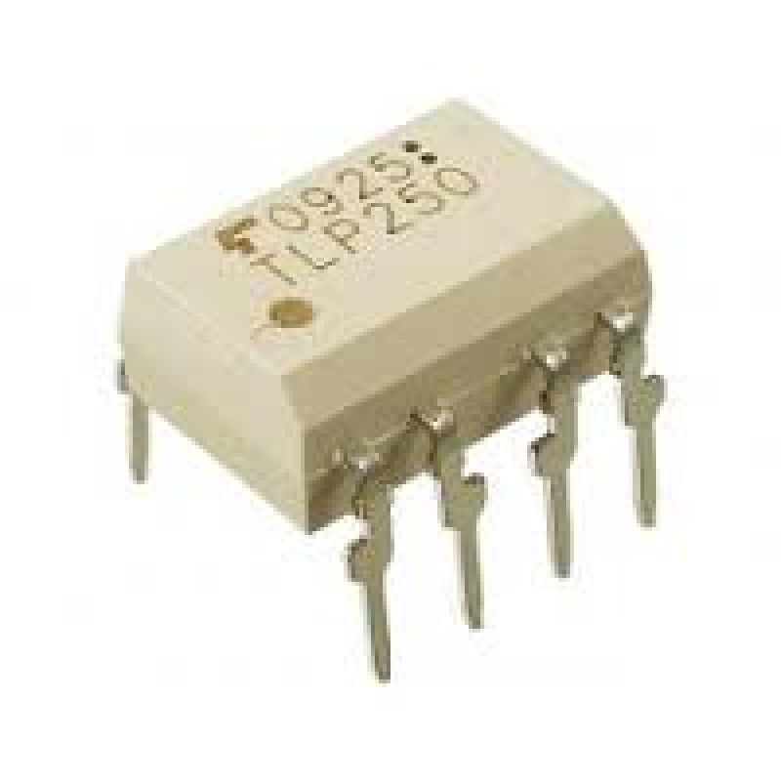
Isolation
Isolate input and output
Give enough current to MOSFET’s input
TLP250

Slide 10
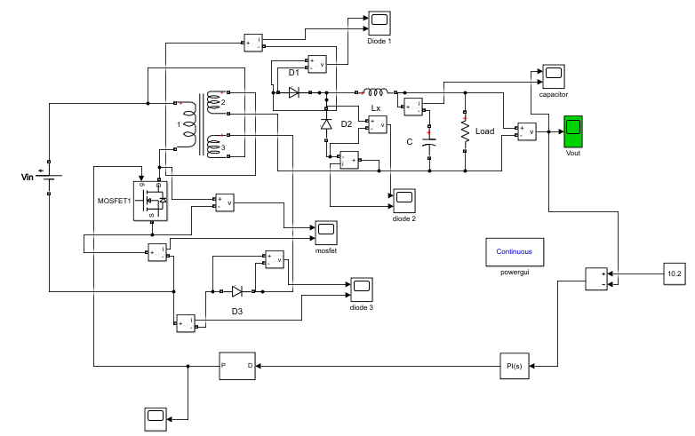
Simulation Results and Component Selection

Slide 11
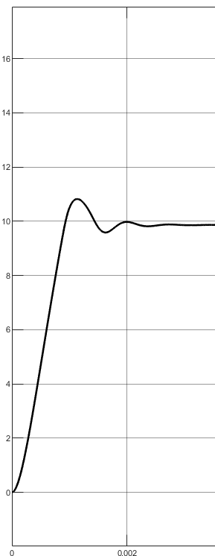
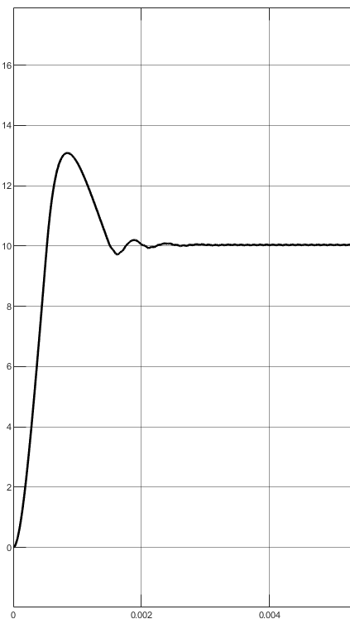
Simulation Results
24V Input
48V Input

Slide 12
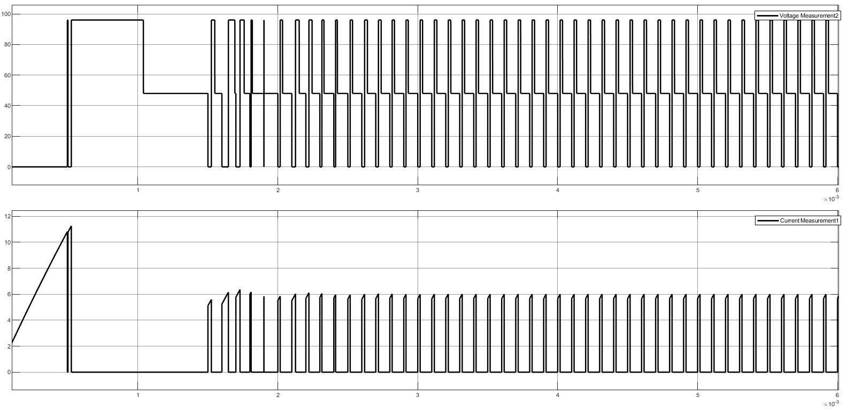
MOSFET Selection

Slide 13
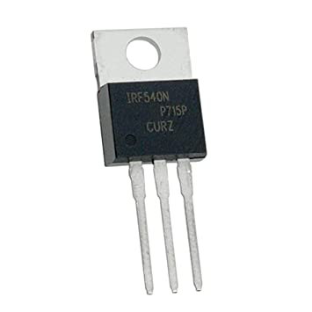
MOSFET Selection
96 V, 6 A stress
100 V, 27 A rating
IRF540N

Slide 14
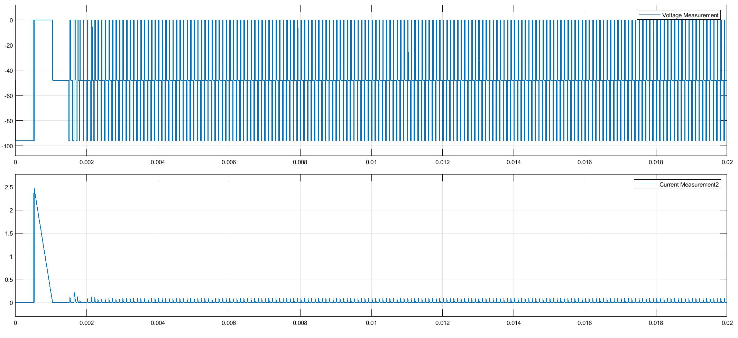
Diode Selection (Input Graph)

Slide 15
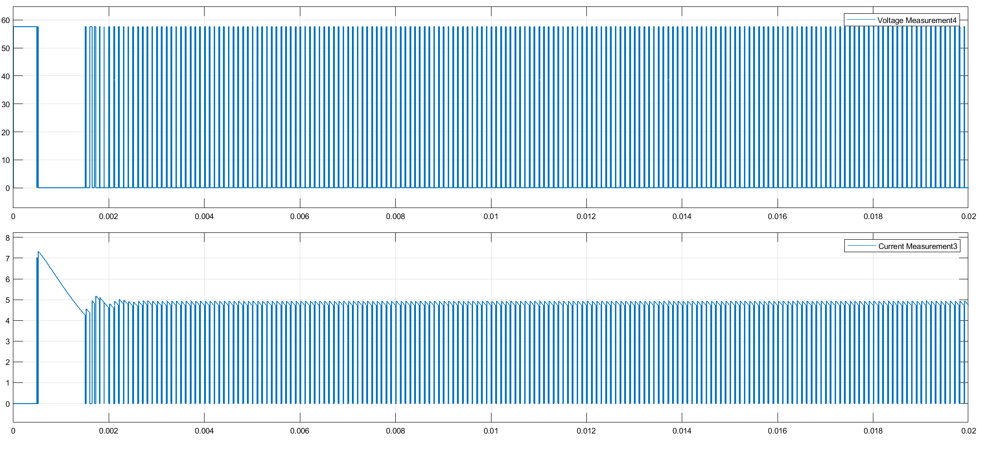
Diode Selection (Output Graph)

Slide 16
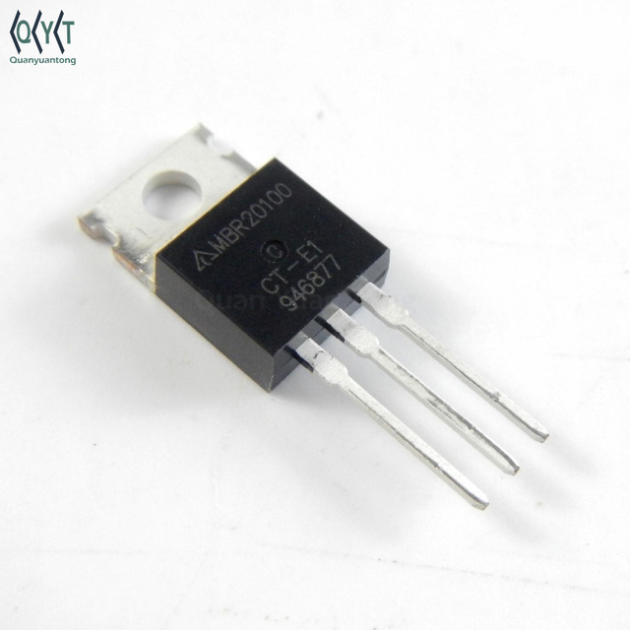
Diode Selection
96 V, 2.5 A stress (input)
58 V, 6 A stress (output)
100 V, 20 A rating
Schottky Diode (Fast recovery)
MBR20100

Slide 17
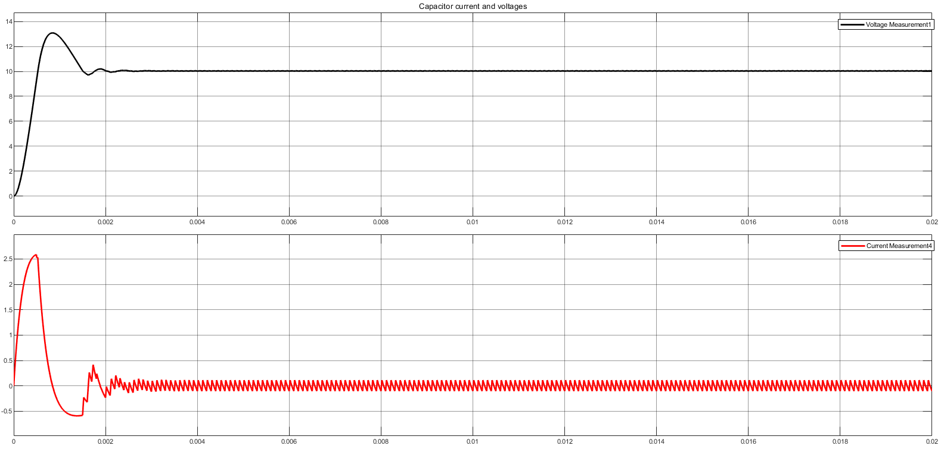
Capacitor Selection

Slide 18
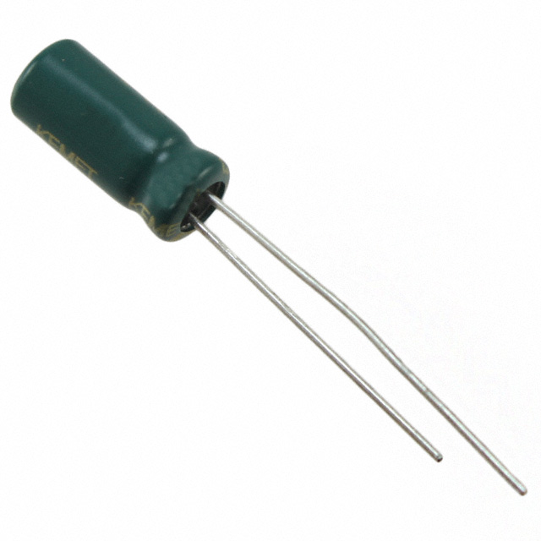
Capacitor Selection
Reduce voltage ripple (100 mF)
Small ESR (900 mOhm at 100 kHz)
16 V rating
ESC107M016AC3AA

Slide 19
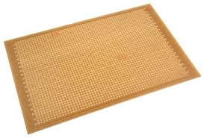
Manufacturing
Build transformer, measure values
Build the circuit in stripboard first
PCB design and manufacturing

Slide 20
QUESTIONS ?

